Slide 1
Approximation Algorithms
Presentation for use with the textbook, Algorithm Design and Applications, by M. T. Goodrich and R. Tamassia, Wiley, 2015

Slide 2
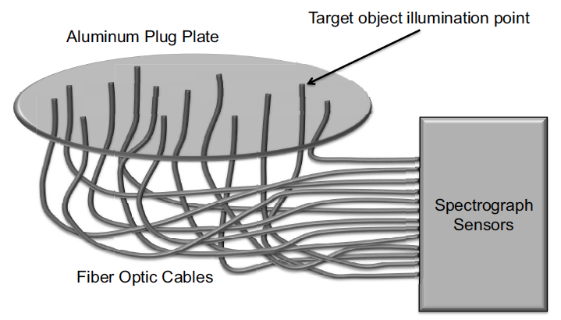
Applications
One of the most time-consuming parts of astronomy involves collecting the light from the galaxy or star over a given period of time.
To do this with a telescope, a large aluminum disk the size of the diameter of the telescope is used.
This disk is placed in the focal plane of the telescope, so that the light from each stellar objects in an observation falls in a specific spot on the disk.
The astronomers use robotic drilling equipment to drill a hole in each spot of interest and they insert a fiber-optic cable into each such hole and connect it to a spectrograph.

Slide 3
Application to TSP
Drilling the holes in the fastest way is an instance of the Traveling Salesperson Problem (TSP).
According to this formulation of TSP, each of the hole locations is a “city” and the time it takes to move a robot drill from one hole to another corresponds to the distance between the “cities” for these two holes.
Thus, a minimum-distance tour of the cities that starts and ends at the resting position for the robot drill is one that will drill the holes the fastest.
Unfortunately, TSP is NP-complete.
So it would be ideal if we could at least approximate this problem.

Slide 4
Application to Set Cover
Another optimization problem is to minimize the number of observations needed in order to collect the spectra of all the stellar objects of interest.
In this case, we want to cover the map of objects with the minimum number of disks having the same diameter as the telescope.
This optimization problem is an instance of the set cover problem.
Each of the distinct sets of objects that can be included in a single observation is given as an input set and the optimization problem is to minimize the number of sets whose union includes all the objects of interest.
This problem is also NP-complete, but it is a problem for which an approximation to the optimum might be sufficient.

Slide 5
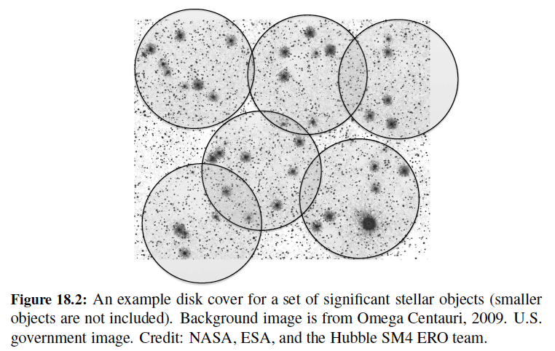
Set Cover Example

Slide 6
Approximation Ratios
Optimization Problems
We have some problem instance x that has many feasible “solutions”.
We are trying to minimize (or maximize) some cost function c(S) for a “solution” S to x. For example,
Finding a minimum spanning tree of a graph
Finding a smallest vertex cover of a graph
Finding a smallest traveling salesperson tour in a graph
An approximation produces a solution T
T is a k-approximation to the optimal solution OPT if c(T)/c(OPT) < k, assuming a minimum.
A maximization inequality approximation would be the reversed to ≥ k.

Slide 7
Special Case of the Traveling Salesperson Problem
OPT-TSP: Given a complete, weighted graph, find a cycle of minimum cost that visits each vertex.
OPT-TSP is NP-hard
Special case: edge weights satisfy the triangle inequality (which is common in many applications):
w(a,b) + w(b,c) > w(a,c)
b
5
4
a
c
7

Slide 8
A 2-Approximation for TSP Special Case
Algorithm TSPApprox(G)
Input weighted complete graph G, satisfying the triangle inequality
Output a TSP tour T for G
M ← a minimum spanning tree for G
P ← an Euler tour traversal of M, starting at some vertex s
T ← empty list
for each vertex v in P (in traversal order)
if this is v’s first appearance in P then T.insertLast(v)
T.insertLast(s)
return T
Euler tour
P
of MST
M
Output tour
T

Slide 9
A 2-Approximation for TSP Special Case - Proof
The optimal tour is a spanning tour; hence |M|<|OPT|.
The Euler tour P visits each edge of M twice; hence |P|=2|M|
Each time we shortcut a vertex in the Euler Tour we will not increase the total length, by the triangle inequality (w(a,b) + w(b,c) > w(a,c)); hence, |T|<|P|.
Therefore, |T|<|P|=2|M|<2|OPT|
Output tour
T
Euler tour
P
of MST
M
Optimal tour
OPT
(at most the cost of
P
)
(twice the cost of
M
)
(at least the cost of MST
M
)

Slide 10
Vertex Cover
A vertex cover of graph G=(V,E) is a subset W of V, such that, for every (a,b) in E, a is in W or b is in W.
OPT-VERTEX-COVER: Given an graph G, find a vertex cover of G with smallest size.
OPT-VERTEX-COVER is NP-hard.

Slide 11
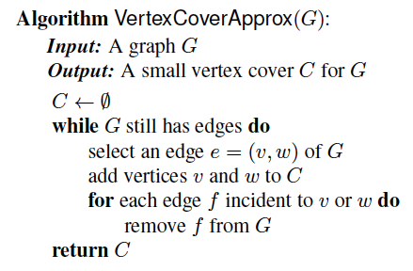
A 2-Approximation for Vertex Cover
Every chosen edge e has both ends in C
But e must be covered by an optimal cover; hence, one end of e must be in OPT
Thus, there is at most twice as many vertices in C as in OPT.
That is, C is a 2-approx. of OPT
Running time: O(n+m)

Slide 12
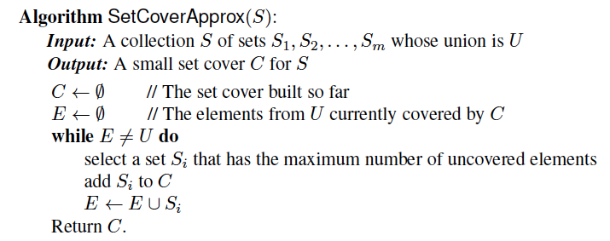
Set Cover (Greedy Algorithm)
OPT-SET-COVER: Given a collection of m sets, find the smallest number of them whose union is the same as the whole collection of m sets?
OPT-SET-COVER is NP-hard
Greedy approach produces an O(log n)-approximation algorithm.

Slide 13
Greedy Set Cover Analysis
Consider the moment in our algorithm when a set S_{j} is added to C, and let k be the number of previously uncovered elements in S_{j}.
We pay a total charge of 1 to add this set to C, so we charge each previously uncovered element i of S_{j} a charge of c(i) = 1/k.
Thus, the total size of our cover is equal to the total charges made.
To prove an approximation bound, we will consider the charges made to the elements in each subset S_{j} that belongs to an optimal cover, C ′. So, suppose that S_{j} belongs to C ′.
Let us write S_{j} = {x₁, x₂, . . . , x_{nj} } so that S_{j}’s elements are listed in the order in which they are covered by our algorithm.

Slide 14
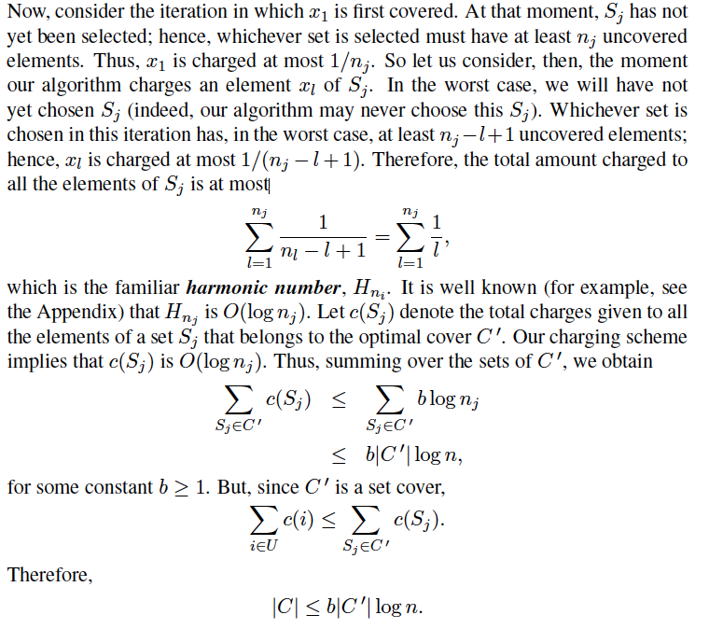
Greedy Set Cover Analysis, cont.

Slide 15
Polynomial-Time Approximation Schemes
A problem L has a Polynomial-Time Approximation Scheme (PTAS) if it has a polynomial-time (1+ε)-approximation algorithm, for any fixed ε >0 (this value can appear in the running time).
Often called δ-approximation algorithm, where δ= 1+ε
0/1 Knapsack has a PTAS, with a running time that is O(n³/ ε).

